Slide 1
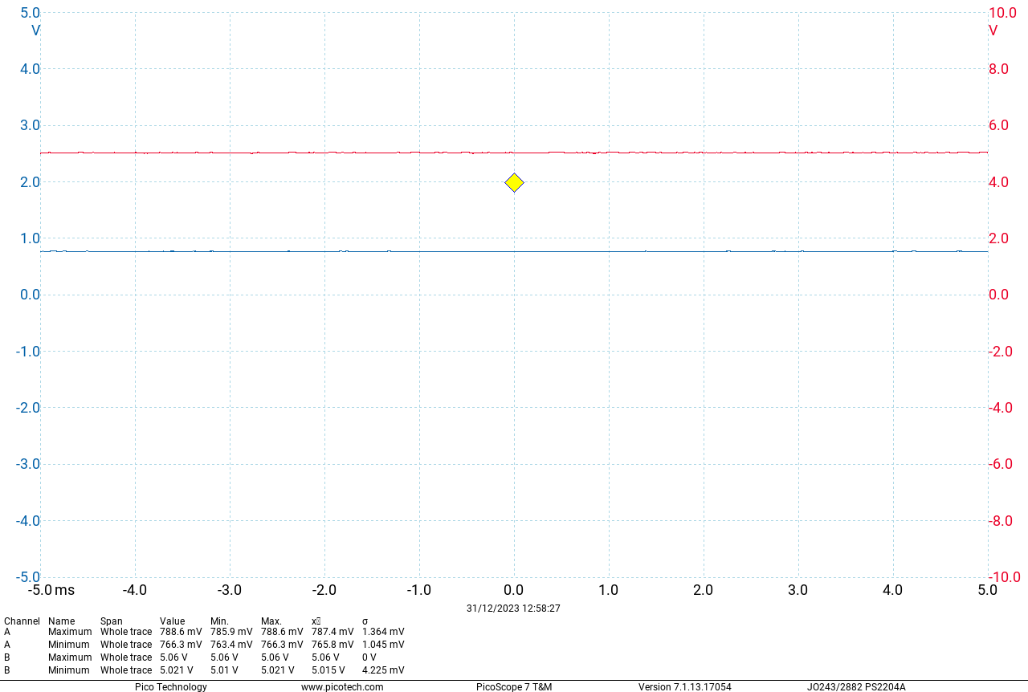
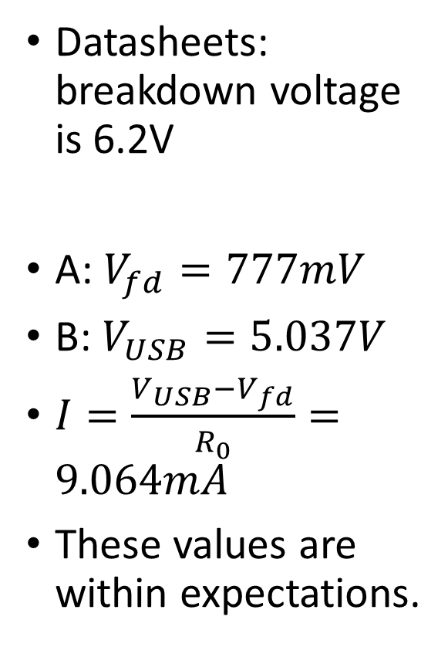
Exercise 6
Datasheets: breakdown voltage is 6.2V
A: $V_{fd}=777mV$
B: $V_{USB}=5.037V$
$I=\frac{V_{USB}−V_{fd}}{R_{0}}=9.064mA$
These values are within expectations.

Slide 2
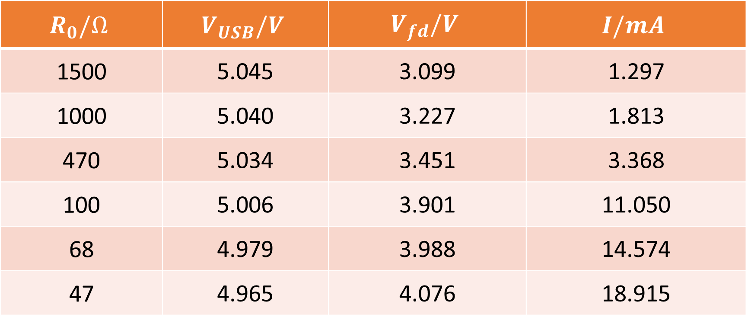
Exercise 6
$$R_{0}/Ω$$ | $$V_{USB}/V$$ | $$V_{fd}/V$$ | $$I/mA$$
1500 | 5.045 | 3.099 | 1.297
1000 | 5.040 | 3.227 | 1.813
470 | 5.034 | 3.451 | 3.368
100 | 5.006 | 3.901 | 11.050
68 | 4.979 | 3.988 | 14.574
47 | 4.965 | 4.076 | 18.915

Slide 3
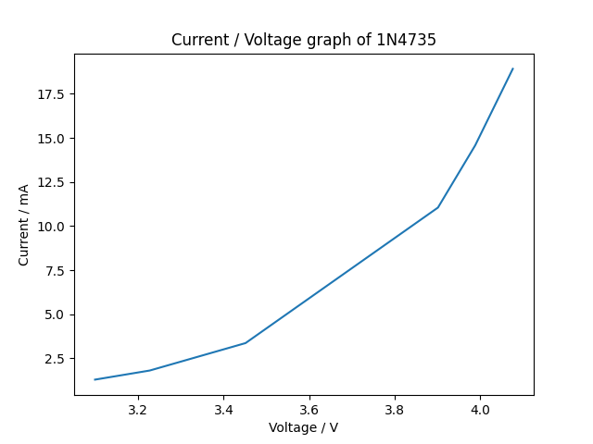
Exercise 6

Slide 4
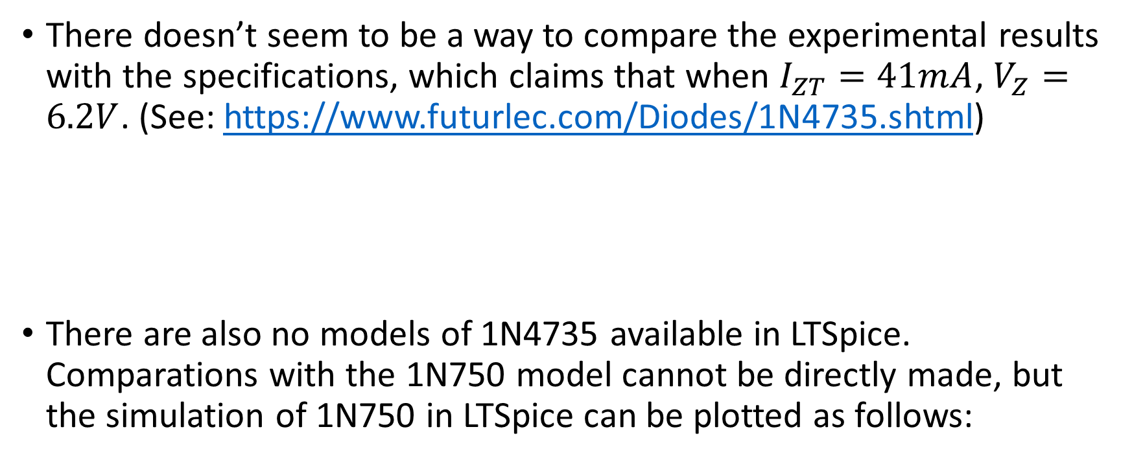
Exercise 6
There doesn’t seem to be a way to compare the experimental results with the specifications, which claims that when $I_{ZT}=41mA$, $V_{Z}=6.2V$. (See: https://www.futurlec.com/Diodes/1N4735.shtml)
There are also no models of 1N4735 available in LTSpice. Comparations with the 1N750 model cannot be directly made, but the simulation of 1N750 in LTSpice can be plotted as follows:

Slide 5
Exercise 6

Slide 6
Exercise 6
Although not very obvious, we may notice a similar trend of increasing slope in both plots.

